Slide 1



Consumer Goods Ad-hoc Insights Presented by Shivam Kapoor
CodeBasics Resume Project Challenge

Slide 2
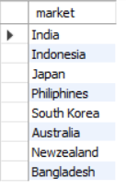
Request 1
Provide the list of markets in which customer "Atliq Exclusive" operates its business in the APAC region.
Output

Slide 3
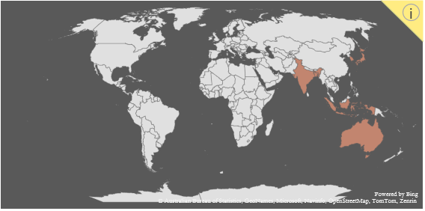
Visualization & Insights of Output
Customer "Atliq Exclusive“ operates its business in India, Indonesia, Japan, Philippines, South Korea, Australia, New Zealand and Bangladesh in APAC Region

Slide 4
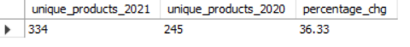
Request 2
What is the percentage of unique product increase in 2021 vs. 2020? The final output contains these fields,
unique_products_2020
unique_products_2021
percentage_chg
Output

Slide 5
Visualization & Insights of Output
Unique products in 2021 are 334 and in 2020 are 245 there is 36.33% increase in unique products in 2021

Slide 6
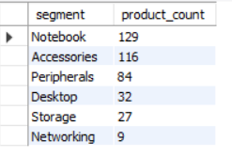
Request 3
Provide a report with all the unique product counts for each segment and sort them in descending order of product counts. The final output contains 2 fields,
Segment
Product_count
Output

Slide 7
Visualization & Insights of Output
Highest no. of unique products are 129 and 116 in Notebook and Accessories category respectively then 84, 32, 27, 9 in Peripherals Desktop Storage Networking respectively.

Slide 8
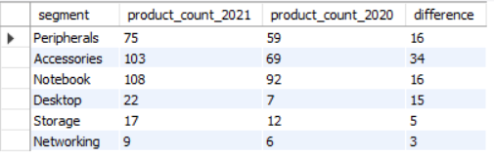
Request 4
Follow-up: Which segment had the most increase in unique products in 2021 vs 2020? The final output contains these fields,
Segment
product_count_2020
product_count_2021
difference
Output

Slide 9
Visualization & Insights of Output
Segment Accessories have most increase in unique products i.e.
34

Slide 10
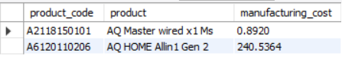
Request 5
Get the products that have the highest and lowest manufacturing costs. The final output should contain these fields,
Product_code
Product
manufacturing_cost
Output

Slide 11
Visualization & Insights of Output
Products AQ Master wired x1 Ms has lowest and AQ HOME Allin 1 Gen 2 has highest manufacturing cost 0.8920 and 240.54 respectively.

Slide 12
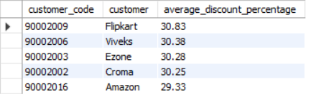
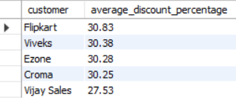
Request 6
Generate a report which contains the top 5 customers who received an average high pre_invoice_discount_pct for the fiscal year 2021 and in the Indian market. The final output contains these fields,
customer_code
Customer
average_discount_percentage
Output

Slide 13
Visualization & Insights of Output
In actual vijay sales is our 5th customer in terms of average_discount_percentage not Amazon. This result will be achieved if we group by customer only. In this question we suppose to have only 2 columns in result set but codebasics ask for 3 columns that’s why this question will produce wrong result.

Slide 14
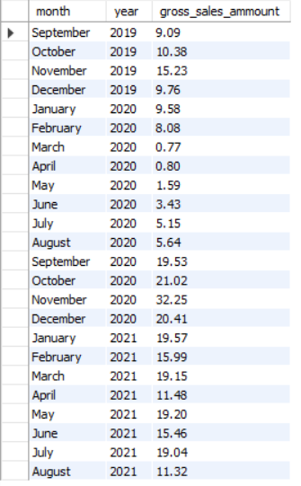
Request 7
Get the complete report of the Gross sales amount for the customer “Atliq Exclusive” for each month. This analysis helps to get an idea of low and high-performing months and take strategic decisions. The final report contains these columns:
Month
Year
Gross sales Amount
Output

Slide 15
Visualization & Insights of Output
November is high performing month in both fiscal year April is low performing month in both year and march in fiscal year 2020.
Overall fiscal year 2021 is high performing then fiscal year 2020

Slide 16
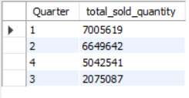
Request 8
In which quarter of 2020, got the maximum total_sold_quantity? The final output contains these fields sorted by the total_sold_quantity,
Quarter
total_sold_quantity
Output

Slide 17
Visualization & Insights of Output
In fiscal year 2020 the highest total quantity was sold in 1st quarter

Slide 18
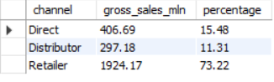
Request 9
Which channel helped to bring more gross sales in the fiscal year 2021 and the percentage of contribution? The final output contains these fields,
Channel
gross_sales_mln
percentage
Output

Slide 19
Visualization & Insights of Output
From three of the channel Direct Distributor and Retailer the Retailer helped us to bring more gross sales $1924.17 mln that is 73.22% out of total sales in fiscal year 2021.

Slide 20
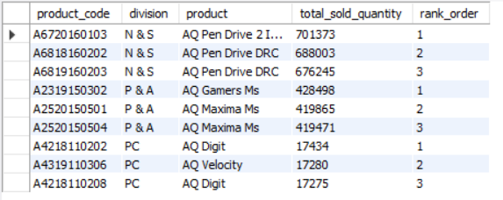
Request 10
Get the Top 3 products in each division that have a high total_sold_quantity in the fiscal_year 2021? The final output contains these fields,
Division
product_code
Product
total_sold_quantity
rank_order
Output

Slide 21
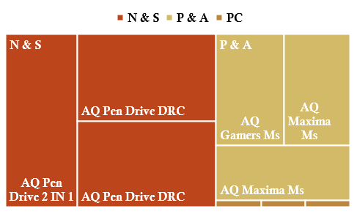
Visualization & Insights of Output
The above Treemap visual and sql result set tells the whole story I don’t think I need to write some insights.

Slide 22
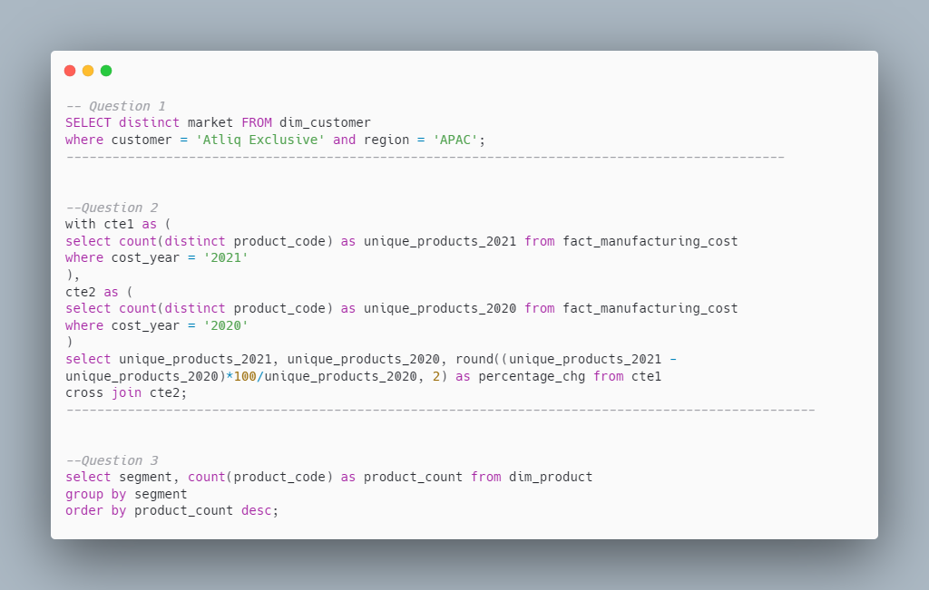
SQL QUERIES

Slide 23
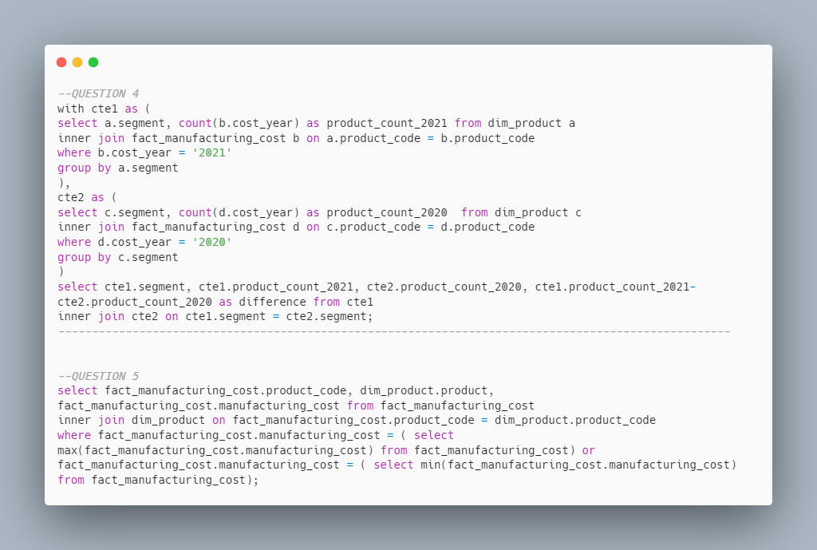

Slide 24
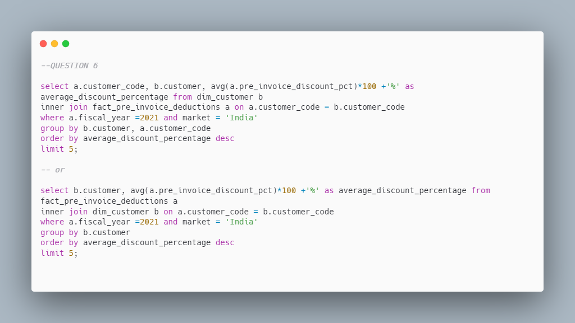

Slide 25
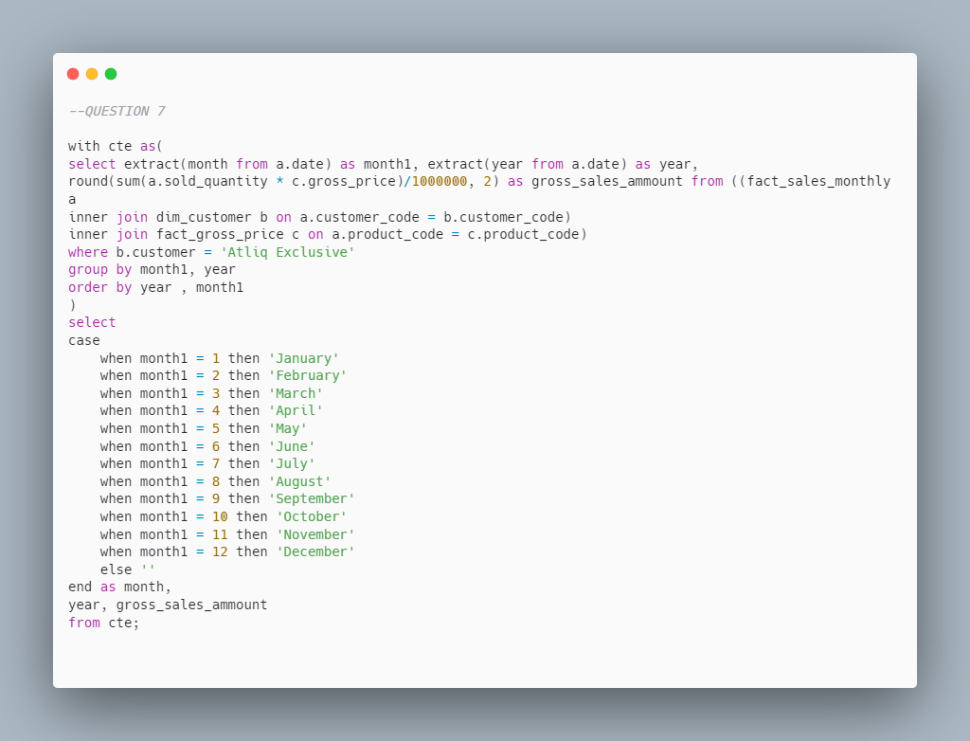

Slide 26
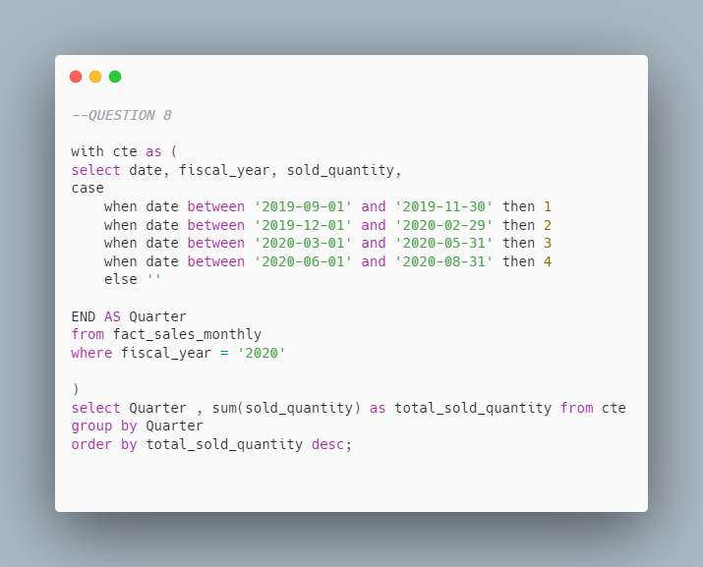

Slide 27
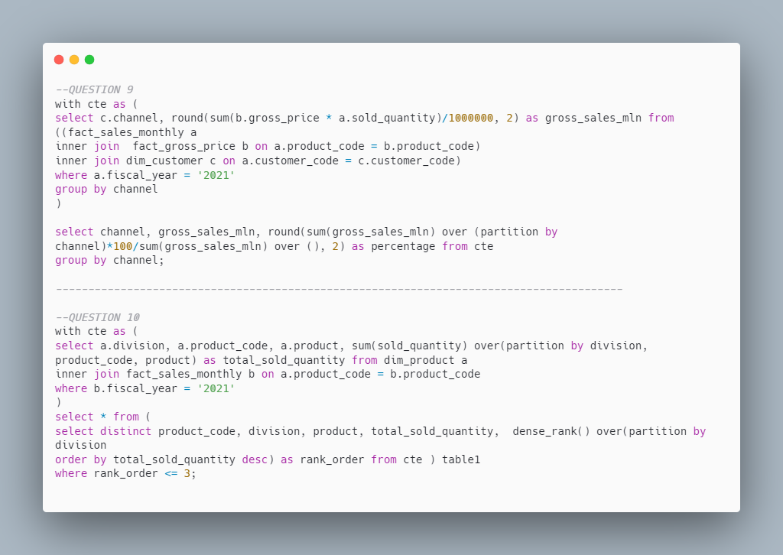

Slide 28



THANK YOU

